Slide 2
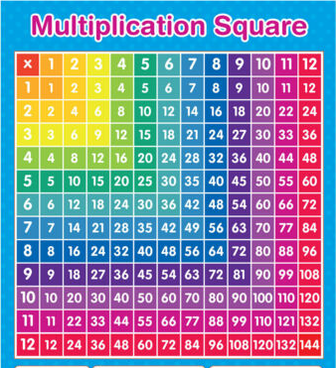
Times tables

Slide 3
Towards the end of Year 4, children take a Multiplication Tables Check. This is made up of 25 randomly generated multiplication questions and children are given 6 seconds to correctly answer each one. Although this is a Year 4 assessment, ground work begins in Year 2 and continues throughout Years 2, 3 and 4.
The official pass mark given by the Government for this test is 25/25.
Our goal as a school is to aim for a score of at least 22/25, with as many children getting full marks as possible.

Slide 4
Learning times tables is a process which requires repeated practice; the more times your child practices, the quicker and more accurate they will become.
We are going to be showing you some strategies that you can use at home to support your child with this.

Slide 5
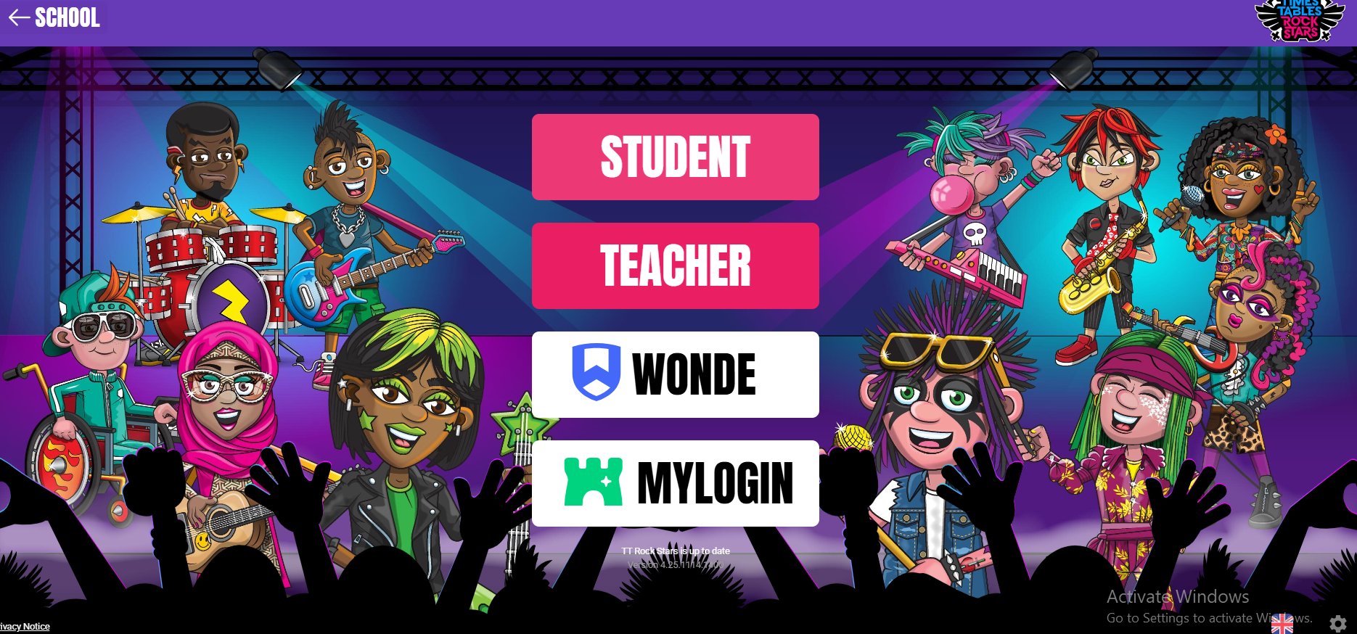
Online resources
Firstly, your child has access to Times Table Rockstars, which we use in school. This is a fun and interactive way of practicing times tables and all children love it. It can be used on any device which connects to the internet. Just 10 minutes a day is all it needs!

Slide 6
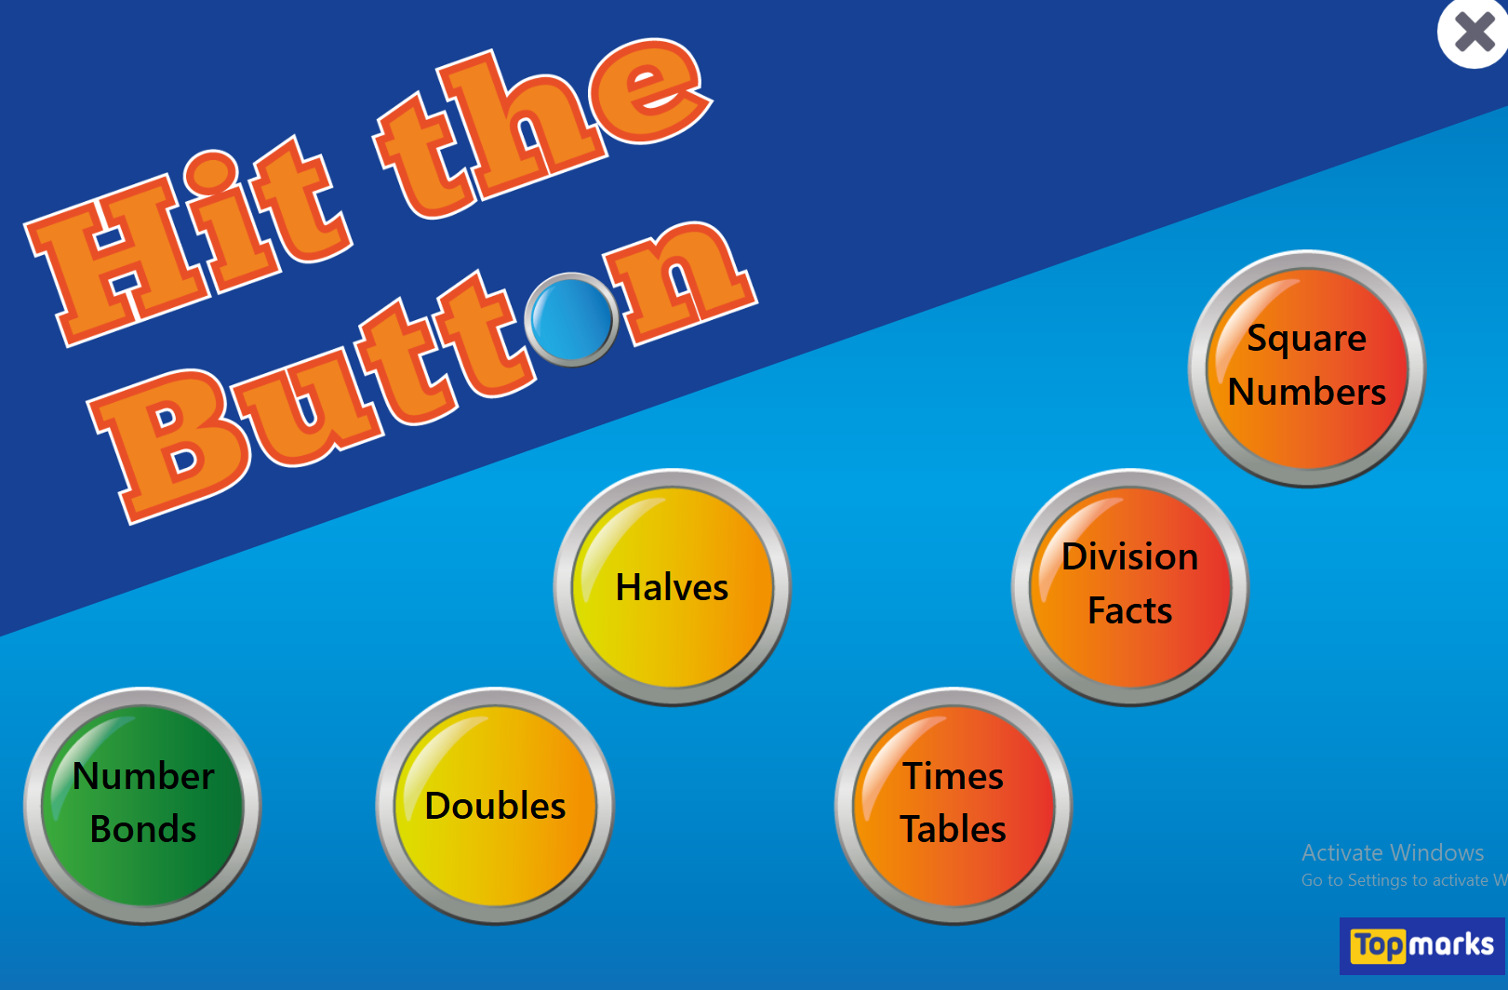
There is also an online game called ‘Hit the button’, where children or parents can choose a specific times table to practice or use a mixture. Again, this is interactive and fun, and could be used as a competition Child vs Parent!

Slide 7
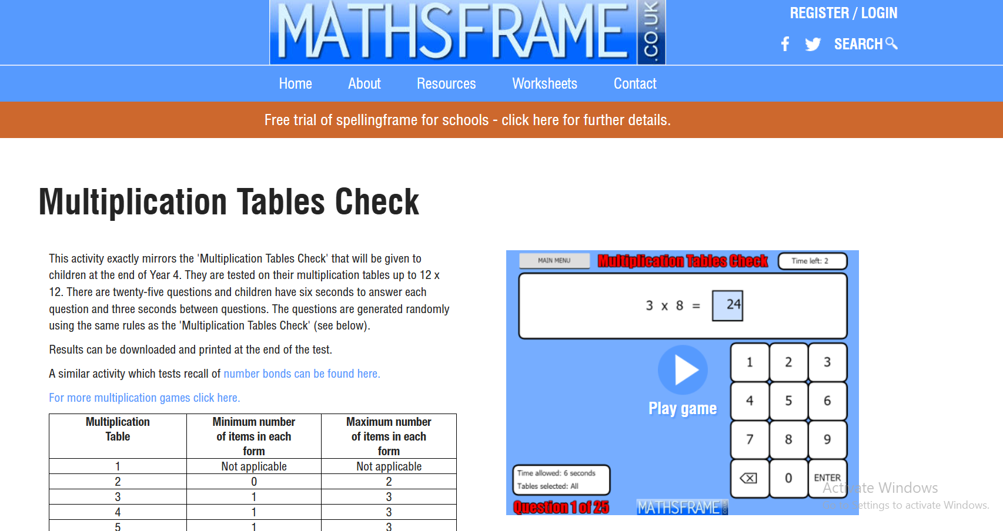
We use Maths Frame Multiplication Check on a weekly basis, which is very similar to the official check and we urge you to use this at home too.

Slide 8
There are also lots of games and strategies you can use at home to help your child to learn their times tables – you will find these in your handouts.
We will show you a few things that we do in school to support learning times tables, ones that you could have a go at home too – on a car journey, while you’re cooking, bedtime etc.

Slide 9
Fact of the day/week
Choose a fact per day/per week to constantly rehearse at home. You could put it on post it notes around the house, as lunchbox notes, practice it in the car… The possibilities are endless!
Make sure you practice the question both ways round, for example 4 x 2 = 8 and 2 x 4 = 8.

Slide 10
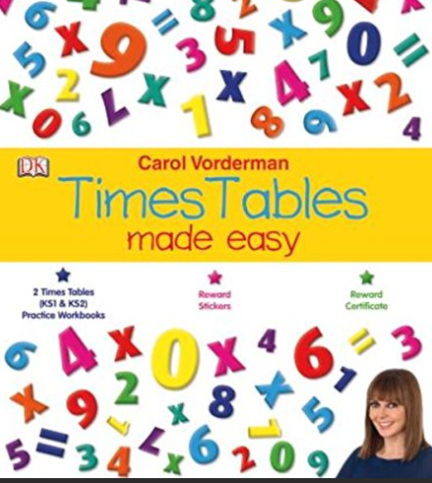
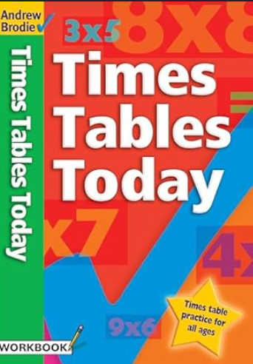
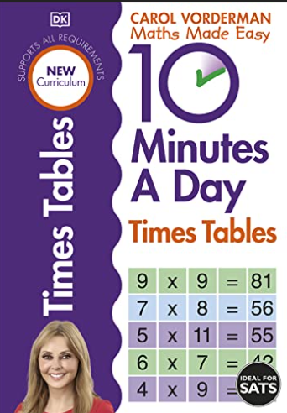
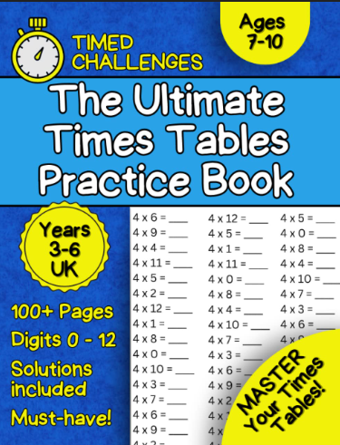
Have a times table poster up! The Poundshop has some brilliant ones or we have sent home a sheet which can be put somewhere they look all of the time.
Supermarkets/bookshops have some fantastic books to support learning tables. Carol Vorderman ones are great or there’s some colouring by numbers online that can be printed out.

Slide 11
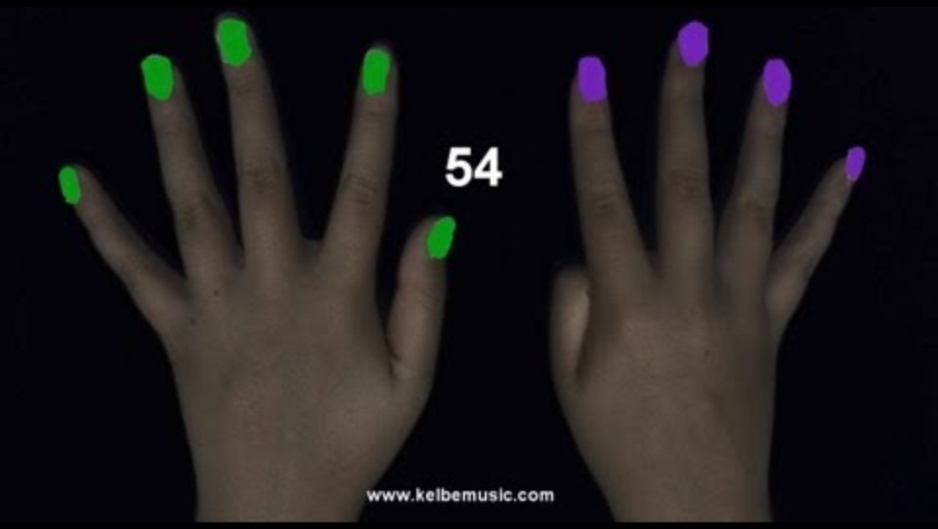
Times table tricks – the 9 x table.

Slide 12
Stage a multiplication war!
This game is simple, two players draw a card from a deck (the UNO card deck is brilliant for this!)
They then flip their cards over and the first person to correctly answer the total of the two cards multiplied together gets to put the cards in their winning pile. For example, if a 3 7 of diamonds are flipped over, the first person who says 21 gets to keep the two cards. The person with the most cards in their winning pile at the end of the game wins.

Slide 13
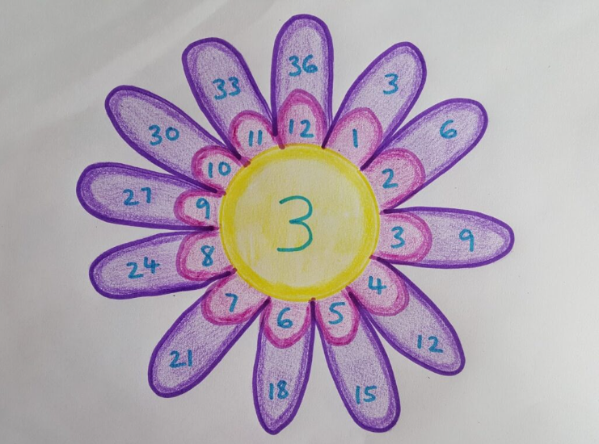
Make a multiplication flower
Another one for displaying in the house, is to create a multiplication flower. Children start this activity by drawing the centre of the flower, in which they write a number between 2 and 12. They then draw 12 petals around the centre, with each petal containing the numbers 1 through 12. The last step is to draw another set of 12 petals which contain the centre number multiplied by each petal in the inner circle.

Slide 14
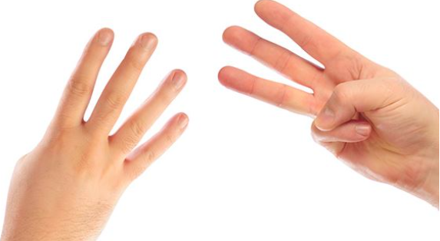
Rock, Paper, Times tables!
A different spin on Rock, Paper, Scissors. You count in as normal, but when you would normally show your rock, paper or scissors, you hold up a number of fingers between 1 and 10. The first to multiply both numbers together wins.

Slide 15

Sing!
There are loads of free times table songs on platforms such as YouTube. Music is proven to be a good way of remembering things. We do this in the lunchtime club and we love it!

Slide 16
We now have a few games and activities to complete with your child. Let’s have some fun!

